Slide 1
Presenting data
21/02/2024
Year 7 Science

Slide 2
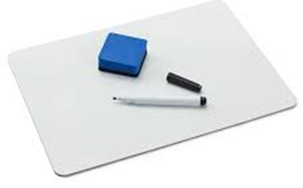
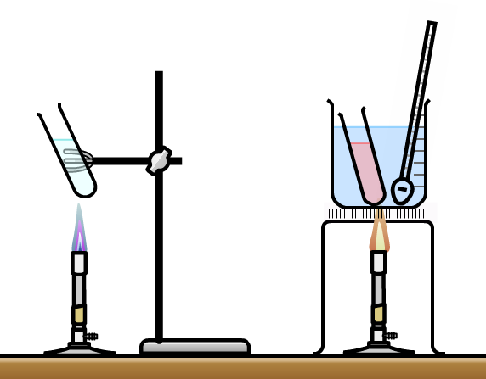
Review:
Write two safety rules for the laboratory.
Name these pieces of equipment:

Slide 3
Learning Intentions
Construct and use a range of representations, including graphs, keys and models to represent and analyse patterns or relationships

Slide 4
Success criteria
Classify data as numerical (quantitative) or non-numerical (qualitative)
Classify numerical data as continuous, grouped or discrete (non-continuous)
Select the right type of graph for the data

Slide 5
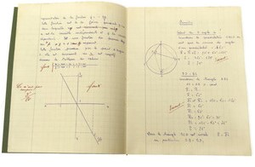
Types of data 21/02/2024
Qualitative, eg colour, type of car, favourite song
Quantitative, eg numbers or measurements
- discrete, eg number of students, number of cars
- grouped, eg ages, days or months
- continuous, eg time, height, mass

Slide 6
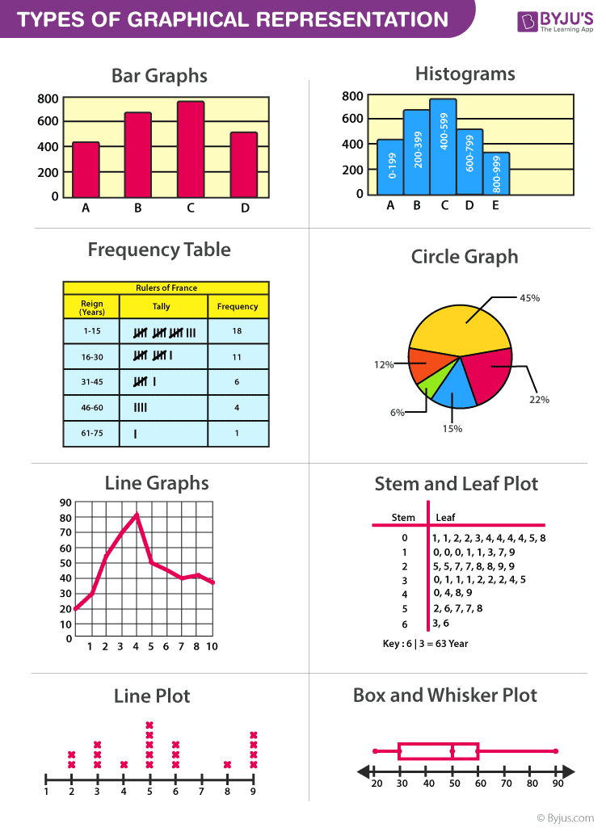
Types of graphs

Slide 7
Types of graphs

Slide 8
Types of graphs

Slide 9

Suffocating candles

Slide 11
Choosing your scale
Biggest – smallest value
Count how many squares or measure how big in cm you want your graph to be
Round up to the nearest 2, 5, 10 etc to make it easier

Slide 12
Success criteria
Classify data as numerical (quantitative) or non-numerical (qualitative)
Classify numerical data as continuous, grouped or discrete (non-continuous)
Select the right type of graph for the data

Slide 13
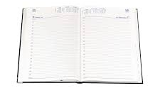
Homework sheet – reading scales
Due Monday 19 Feb

